Slide 1
Username: conf9216 Password: 2arotard Username: conf9217 Password: ndinka5a
WiFi:

Slide 2
Welcome!
November 2015
Vishesh Oberoi
Technical Evangelist, Microsoft
@ovishesh
visho@microsoft.com
github.com/ovishesh
Microsoft Azure

Slide 3
Microsoft + Startups
BizSpark
BizSpark Plus
Microsoft Ventures

Slide 4



Microsoft Student Accelerator
Student Internships over Summer
Innovative Projects
Employer Registrations now open!
Register at http://msa.ms

Slide 5
Microsoft!

Slide 6



Empower every person and every organization on the planet to achieve more
Build the intelligent cloud
Reinvent productivity & business process
Create more personal computing
Notes:
Goal of slide: Transition to setting up the keynote, using 3 ambitions
TPs
Empowering every individual and organization is a bold ambition and has required us to push our platforms forward in bold new ways
We will create more personal computing – Windows 10 is a major step forward
We will reinvent productivity and business processes – Office is no longer a set of individual productivity apps – Office is a platform that enables a rich set of social/mobile experiences
We will build the intelligent cloud - in a world where devices will out number people and data is growing exponentially there is a huge opportunity to build intelligent cloud solutions
Never been a better time to be a part of the MS ecosystem as a dev
With that – want to welcome Scott Guthrie to show you more…

Slide 7


Platform opportunity
Azure
Build the intelligent cloud
Reinvent productivity & business process
Create more personal computing
Notes:
Goal of slide: Transition to setting up the keynote, using 3 ambitions
TPs
Empowering every individual and organization is a bold ambition and has required us to push our platforms forward in bold new ways
We will create more personal computing – Windows 10 is a major step forward
We will reinvent productivity and business processes – Office is no longer a set of individual productivity apps – Office is a platform that enables a rich set of social/mobile experiences
We will build the intelligent cloud - in a world where devices will out number people and data is growing exponentially there is a huge opportunity to build intelligent cloud solutions
Never been a better time to be a part of the MS ecosystem as a dev
With that – want to welcome Scott Guthrie to show you more…

Slide 8







1 Billion mobile notifications a month
Yammer has over 8 million registered users
48 Million Subscribers in
41 countries
Office for iOS has been downloaded over 80M times
Outlook.com has over 400 Million active users and is the world’s fastest growing email service
On average, Skype users use the service 50 Billion minutes/mo
Bing holds 20.2 percent of US market share
- comScore
Over 250 million people use OneDrive
Nearly 50 million Office Online users
Xbox delivered over 740 million hours of entertainment

Slide 9
SaaS Solutions
Differentiation
Agility
Cost
Cloud Infrastructure
Journey to the Cloud
Higher-level services
Notes:
We are in the midst of shift in the way we do general computing, and it’s a major shift for everyone – Microsoft included.
Every org will also be transforming sooner, than later.
They will be using SaaS solutions to achieve faster time to value.
They are going to extend their existing DCs with the help of Cloud Infrastructure and Compute to improve cost savings and agility.
They are going to take advantage of higher level services like ML and CAS to engage better with their customers and get more insights into their own business that will help them reinvent their business processes and get a differentiated advantage.
This will inturn help them enable real business transformation.

Slide 10

Leading the journey to the Cloud
SAAS Solutions
Microsoft Dynamics
Enterprise Mobility
Microsoft Enterprise Mobility Suite
Microsoft Azure
Developer + App Platform
Visual Studio Family + Azure App Service
Data + Analytics
Cortana Analytics Suite
Internet of Things
Azure IoT Suite
Cloud Infrastructure
Azure + Azure Stack + Operations Management Suite
Notes:
AWS – Iaas, but no paas or saas
Salesforce – SaaS, but no other

Slide 11

24
Azure regions around the world
Hyper-scale footprint
More than AWS and Google Cloud combined
Azure regions

Slide 12
AutoScale

Slide 13

AutoScale
Web App

Slide 14
AutoScale
Web App

Slide 15
AutoScale
Web App

Slide 16
Visual Studio Team Services: DevOps
Code Repository
Build + Deploy
Load Testing
Release Management
Azure
Visual Studio
Eclipse / XCode
Application Insights and Hockey App

Slide 17
Visual Studio Family
Visual Studio 2015
Visual Studio Code
Other tools
(Eclipse, Xcode, Sublime, IntelliJ, etc)
Most complete developer IDE
Code optimized editor
Visual Studio Team Services
Agile planning + collaboration tools
Source Control repositories
Bug and work item tracking
Continuous integration builds
Load testing
Application performance monitoring
Available on-premises with TFS
Crash analytics
Free for up to 5 users
Best-in-class tools for every developer
Notes:
Took out ALM as a Service as I thought we may have put it in to balance the text. Added ‘Available on prem with TFS at teams request.

Slide 18


Every app
Visual Studio Online
Visual Studio
.NET
Notes:
Talking Points
With the increase and diversity of devices there is an opportunity for developers to reach users where they are.
Also with the power of the cloud, infrastructure and capital expenditures no longer have to be a barrier to creating great applications.
Visual Studio 2015 bridges mobile and the cloud by being the first version built to target mobile-first and cloud-first development.

Slide 19

Every developer
Visual Studio Code
A lightweight code editor that runs on Mac OSX, Linux and Windows
Visual Studio Community
Free, full-featured and extensible tool for developers building non-enterprise applications
Visual Studio Professional
Professional developer tools and services for individual developers or small teams
Visual Studio Enterprise
Enterprise grade solution with advanced capabilities for teams working on projects of any size complexity, including advanced testing and DevOps
Notes:
Talking Points
We have made some changes to the Visual Studio family to better support every developer to achieve more.
Key changes from Visual Studio 2013 is the consolidation of Premium and Ultimate into the Enterprise SKU. We added Code and Community as new free offerings. Community replaces the Express SKUs and Code is a new offering for those looking for a lightweight code editor.

Slide 20
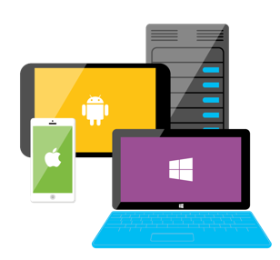

Any
platform
Achieve
more
Team
agility
Notes:
Talking Points
Visual Studio 2015 helps every developer and development team create every type of app in 3 ways:
Support for creating apps on any platform
Get more done faster so you can achieve more
Provide the solutions for teams to be agile in how they collaborate and deliver software

Slide 21
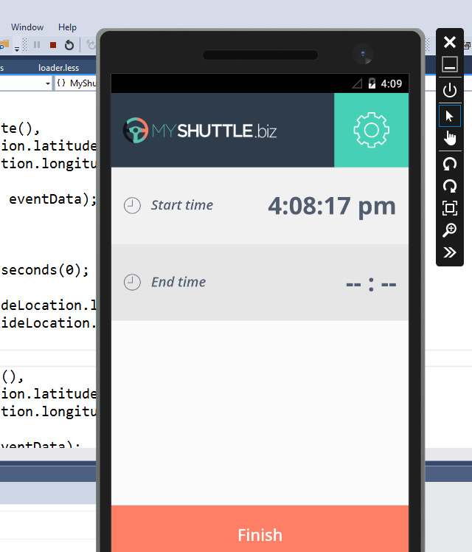
Emulator for Android
Debug Android from Visual Studio
Does not conflict with Hyper-V so you don’t waste time reconfiguring your computer
Launch from Visual Studio 2015 and can use separately
Works with C++, Apache Cordova and C# with Xamarin
Capabilities
Sensor simulation: zoom, orientation/rotation, accelerometer
Hardware simulation: network info, location, battery simulation, screenshots, SD card, camera
Notes:
Talking Points
With the Android Emulator you get a great emulator for testing your Android apps. It includes a variety of capabilities so you can use your app in the emulator as if you were using a physical device.
After you launch the emulator you can use it outside of Visual Studio
Background
Visual Studio Emulator for Android: http://blogs.msdn.com/b/visualstudioalm/archive/2014/11/12/introducing-visual-studio-s-emulator-for-android.aspx

Slide 22
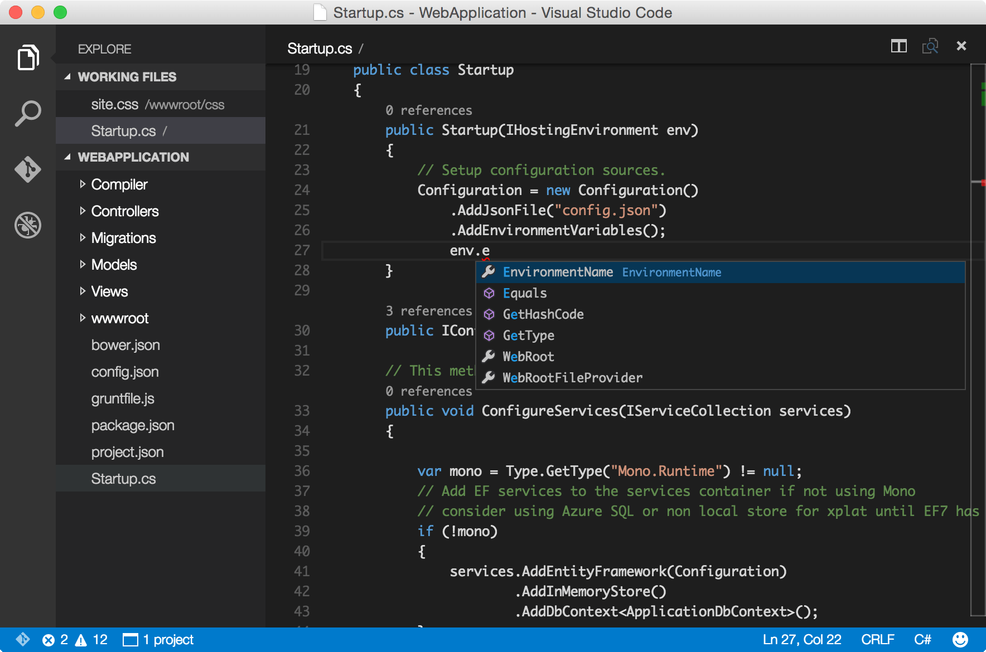
Visual Studio Code Preview
Lightweight and powerful
First class support for ASP.NET and Node.js
Write code in your favorite programming language
Intelligent code authoring, understanding and navigation
Debugging and Git support at your fingertips
Cross-platform
Available for Mac OS X, Linux and Windows
Notes:
Talking Points
Before we discuss web and cloud apps we know that there are times when you need a lightweight code editor to get things done.
Visual Studio Code is a free cross-platform code editor for building modern web and cloud applications. It extends the Visual Studio family by offering a lightweight code editor that runs on Mac OSX, Linux and Windows.
Visual Studio Code redefines code editing, providing a streamlined & fast coding experience with rich code assistance and navigation for multiple languages, with an enhanced set of features for developers building JavaScript, TypeScript, Node.js and ASP.NET 5 applications.

Slide 23
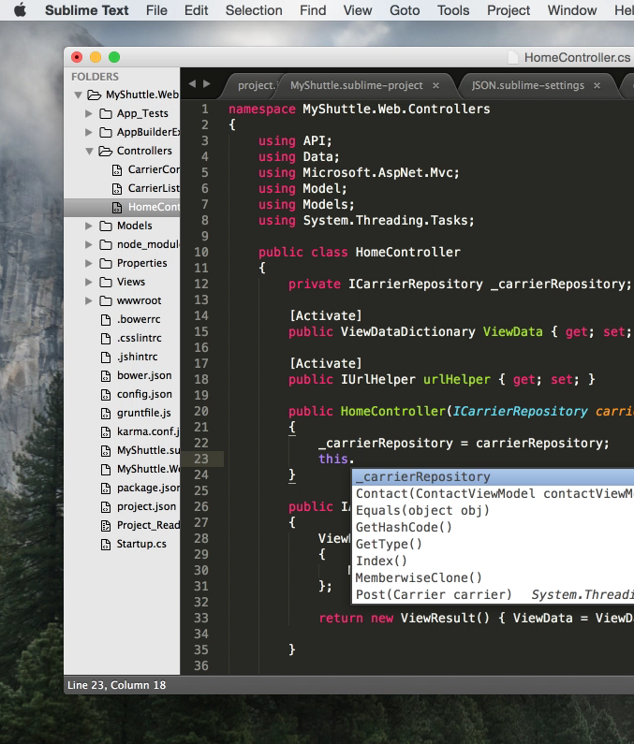
ASP.NET
Cross-platform
Target multiple platforms by deploying your web application to Windows, Linux or Mac
Develop applications on Windows, Linux, or Mac and use any code editor for quick editing
Open
Contribute to the evolution of ASP.NET 5 on GitHub
All developers can use ASP.NET from Visual Studio Community and higher versions
Notes:
Talking Points
In November 2014 Microsoft announced a new era of enabling .NET cloud developers to build .NET cloud applications on multiple platforms. Microsoft is continuing this vision by making ASP.NET cross-platform and open.

Slide 24







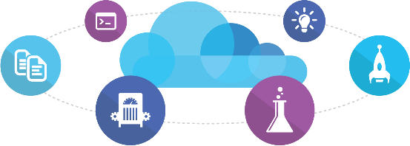
Microsoft Ecosystem
People | Process | Tools
01
02
03
Developer Workstation
Build/CI
04
Release
Develop
Team Foundation Server
Monitor
Build & Test
Deploy
Release Management for Visual Studio
Release Management for Visual Studio
Team Collaboration
Monitor & Learn
Test
Automation Service
Team Foundation Server
Application Insights
Team Foundation Server
PowerShell | WAML
Azure Resource Management
Microsoft Test Manager
xPlat Command Line
TFS
DEV
TEST
QA
Workstations - On-Premises | Hybrid | Cloud
Services - On-Premises | Hybrid | Cloud
Environments - On-Premises | Hybrid | Cloud
Monitoring - On-Premises | Hybrid | Cloud
Notes:
We are going to show you some of this solution set today

Slide 25














Mixed Ecosystem
People | Process | Tools
01
02
03
Developer Workstation
Build/CI
04
Configuration
Develop
Monitor
Build & Test
Deploy
Team Collaboration
Release
Monitor & Learn
Test
This graphic shows OSS and partner products that are integrated with the Microsoft DevOps solution
Notes:
But we want to meet developers and teams where they are. So we support a mixed ecosystem of tools.

Slide 26
Platform opportunity
Office
Build the intelligent cloud
Reinvent productivity & business process
Create more personal computing
Notes:
Goal of slide: Transition to setting up the keynote, using 3 ambitions
TPs
Empowering every individual and organization is a bold ambition and has required us to push our platforms forward in bold new ways
We will create more personal computing – Windows 10 is a major step forward
We will reinvent productivity and business processes – Office is no longer a set of individual productivity apps – Office is a platform that enables a rich set of social/mobile experiences
We will build the intelligent cloud - in a world where devices will out number people and data is growing exponentially there is a huge opportunity to build intelligent cloud solutions
Never been a better time to be a part of the MS ecosystem as a dev
With that – want to welcome Scott Guthrie to show you more…

Slide 27
1 Billion mobile notifications a month
Yammer has over 8 million registered users
48 Million Subscribers in
41 countries
Office for iOS has been downloaded over 80M times
Outlook.com has over 400 Million active users and is the world’s fastest growing email service
On average, Skype users use the service 50 Billion minutes/mo
Bing holds 20.2 percent of US market share
- comScore
Over 250 million people use OneDrive
Nearly 50 million Office Online users
Xbox delivered over 740 million hours of entertainment

Slide 28





Notes:
We’ve been around a long time and we’ve disrupted together – thanks in large part to the partners in the room, we evolved the operating system market and helped establish Graphical User Interfaces
We changed the word processing and spreadsheet world with integrated productivity in Office
And we changed the datacenter landscape by bringing affordable server software to businesses running on commodity PCs
So we have been a big disruptor in the industry…
…and we have been disrupted a few times as well.
The lessons we’ve learned are evidenced everywhere in the transformation Microsoft is undergoing today
In fact, we are in the middle of a disruption to ourselves right now.
Why would a company with such an incredibly successful software business, reinvent itself?
That is exactly what we did with Office 365.
The 90’s we built the leading productivity software in each category.
In the 00’s we integrated our Office investment and reached to servers with SharePoint and Exchange
Over the last 5 years we’ve been on our latest step to devices and the cloud…
Office is an incredibly successful franchise. Today we serve over a billion users who spend on average 2-3 hours a day with it.
And yet, we knew we needed to shift the business to a mobile first, cloud first business
And today we’ve served over 4 trillion emails with Office 365.
It became one of our most successful businesses to date.
So it’s a great example of how disrupting your existing successful business can succeed.
1.2 billion+ users
2–3 hours/day spent in Office apps
100+ million downloads of mobile apps
850 million meetings are created a month
470+ PB of storage
Over 4 trillion emails sent with O365

Slide 29
Opportunity
850 million meetings are created a month
Over 4 trillion emails sent with O365
100+ million downloads of mobile apps
2–3 hours/day spent in Office apps
1.2 billion+ users
470+ PB of storage

Slide 30
Platform opportunity
Windows
Build the intelligent cloud
Reinvent productivity & business process
Create more personal computing
Notes:
Goal of slide: Transition to setting up the keynote, using 3 ambitions
TPs
Empowering every individual and organization is a bold ambition and has required us to push our platforms forward in bold new ways
We will create more personal computing – Windows 10 is a major step forward
We will reinvent productivity and business processes – Office is no longer a set of individual productivity apps – Office is a platform that enables a rich set of social/mobile experiences
We will build the intelligent cloud - in a world where devices will out number people and data is growing exponentially there is a huge opportunity to build intelligent cloud solutions
Never been a better time to be a part of the MS ecosystem as a dev
With that – want to welcome Scott Guthrie to show you more…

Slide 31
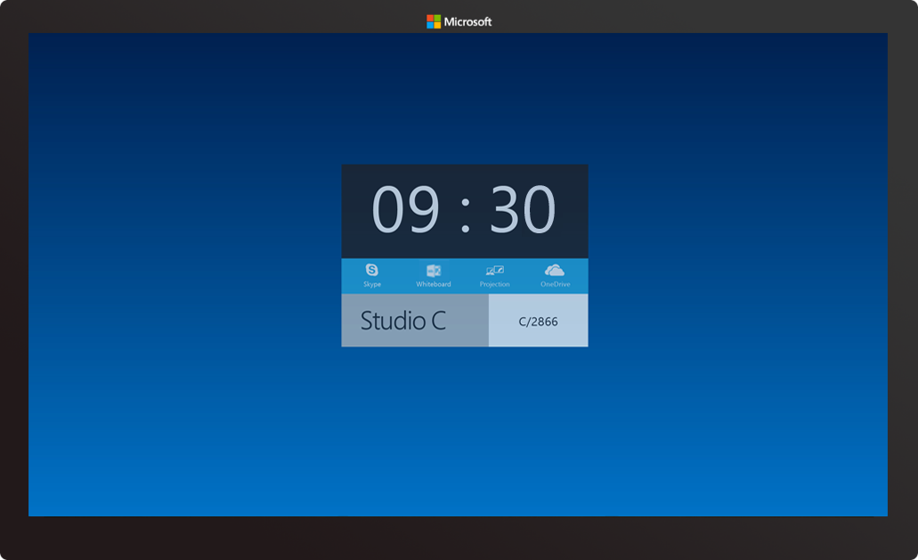
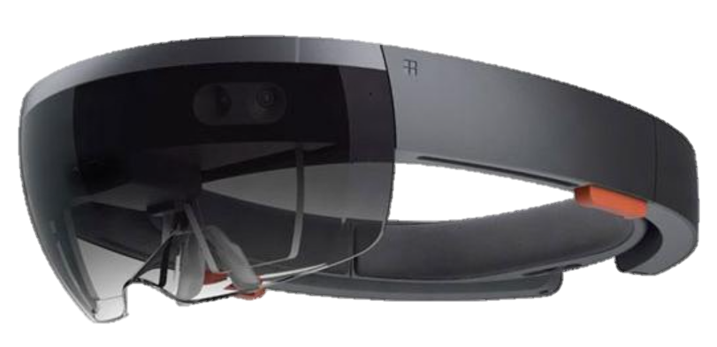

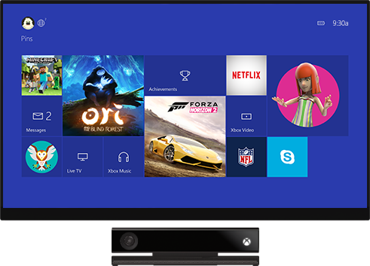
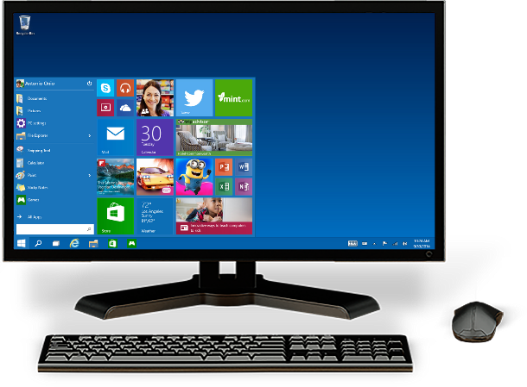
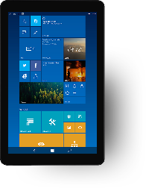
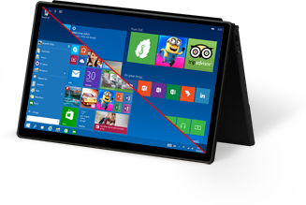
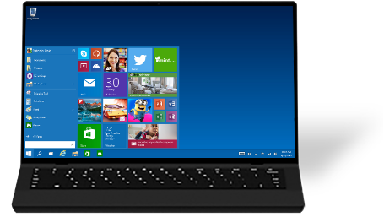

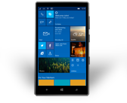
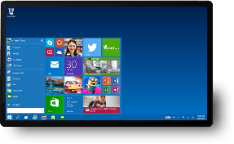
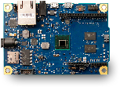
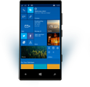
Vishesh Oberoi
Technical Evangelist
Microsoft
VishO@microsoft.com
One product family
One platform
One store

Slide 32
110 Million
More than 110 million devices running Windows 10 – and growing every day.

Slide 33
1 Billion
Windows 10 Devices
Free upgrade for the first year

Slide 34
1 Billion Windows 10 Devices
Windows Store
Universal Windows Platform
Android Java/C++
iOS Objective C
Web
.NET & Win32

Slide 35
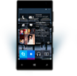

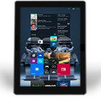
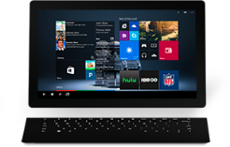

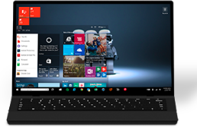

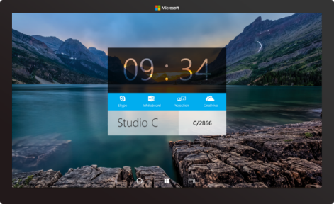

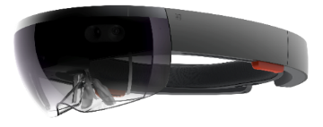



2-in-1s (Tablet or Laptop)
Classic Laptop
Desktops & All-in-Ones
Phone
Phablet
Small Tablet
Large Tablet
Windows 10
Surface Hub
Xbox
Holographic
IoT
Notes:
Windows 10 runs on a wide variety of devices, from phones with a 4.5” screen, through phablets, tablets, PCs, laptops, convertibles such as the Surface, on desktops and All-in-ones, to the Xbox in your living room and right up to giant 84” screens such as our team collaboration device, the Surface Hub. And it also takes in very tiny cheap computers such as the Raspberry Pi 2, and innovative hardware such as the Hololens.

Slide 36
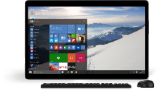
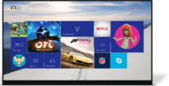
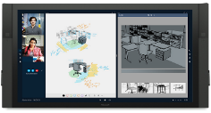




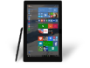
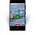











PC
XBox
Mobile
Surface Hub
Devices +IoT
HoloLens
Universal Apps
Multiple device families
Adaptive User Interface
Reuse Existing Code
Natural User Inputs
One Store + One Dev Center
One SDK + Tooling
One Universal Windows Platform
Notes:
We’ve divided this broad range of hardware into different device families – as developers you will likely build apps that target one or more device families.
<click>
We have small devices and IoT, phones and small tablets are in the Mobile device family, large tablets and PCs in the PC (or as we more usually call it, Desktop) family, the Xbox, Surface Hub (or ‘Team’) and finally the Hololens
<click>
And all of these device families run the same developer platform – the Universal Windows Platform. You can build a single app that can run across all these device families using a single SDK and distribute apps through a single store.
Of course, with this diversity of devices, what we are *not* saying is that you should create one app that kind of works adequately across all these devices. No, we want you to create apps that shine on each device family, so we’ve added APIs, controls and tools to help you build an adaptive UI.

Slide 37
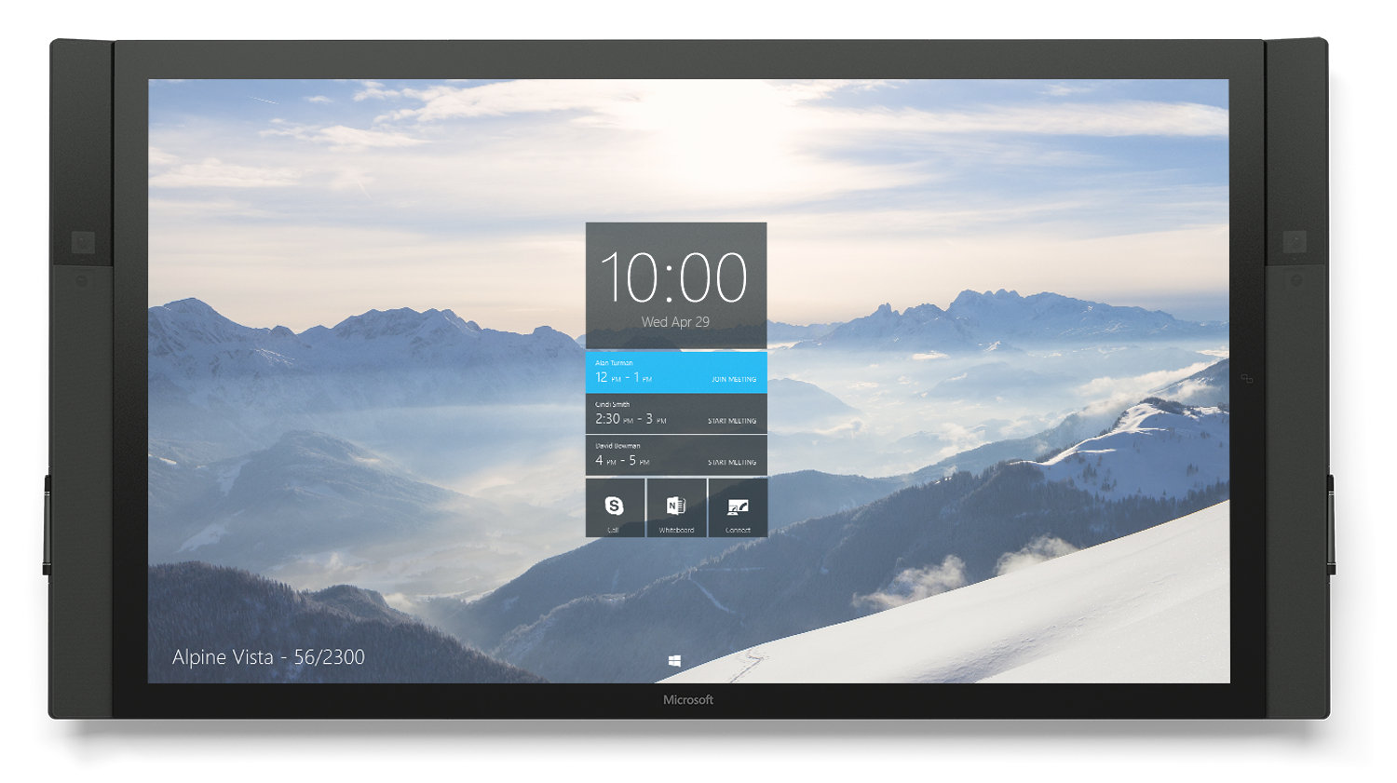
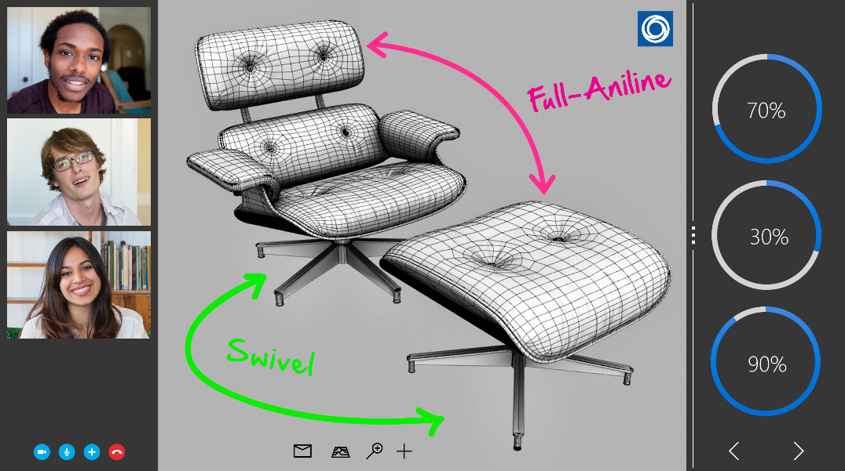
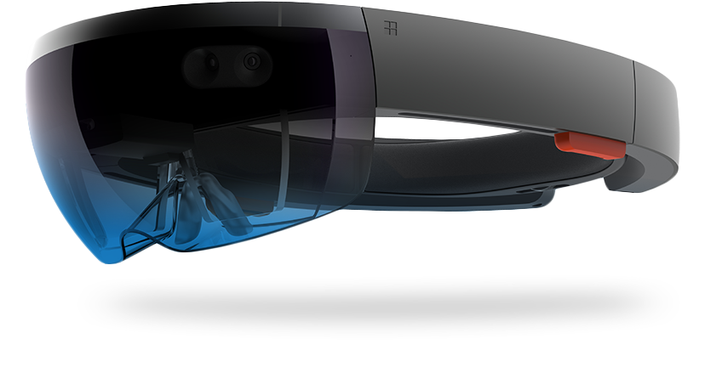
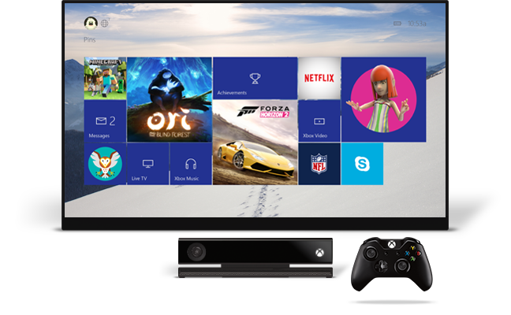
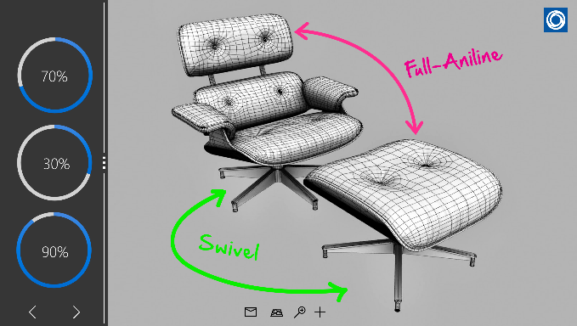
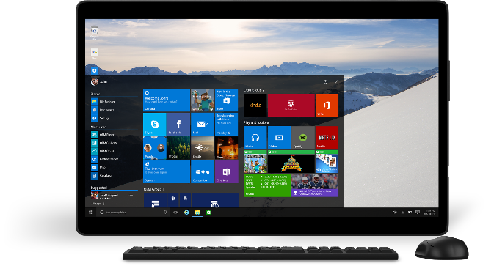
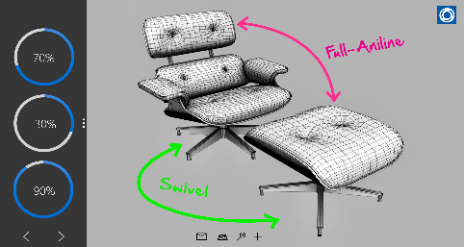
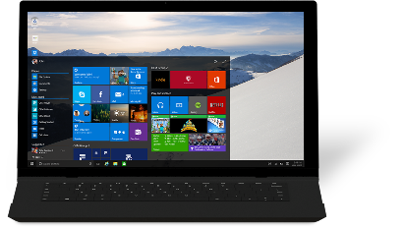
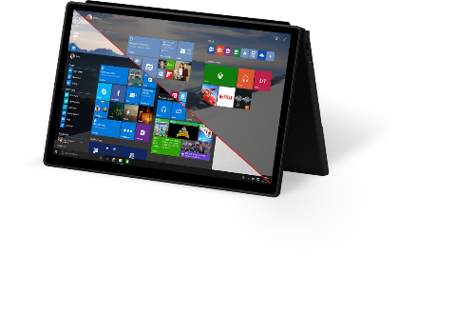
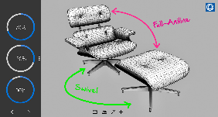
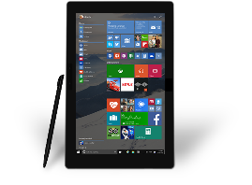
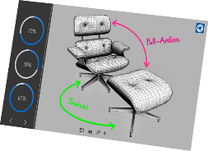
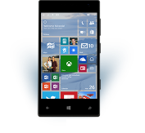
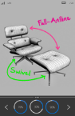



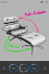

Slide 38
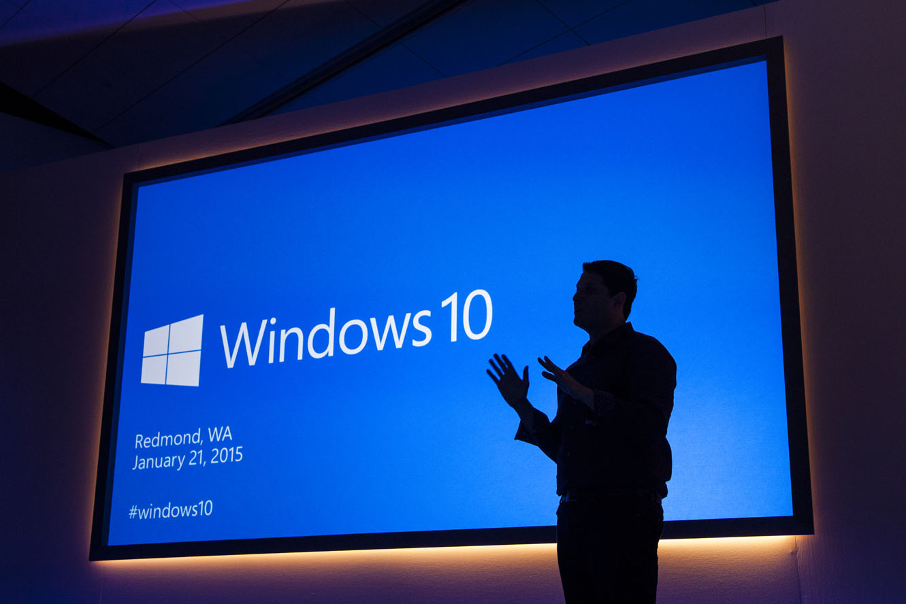
“Windows 10 is the first step to an era of more personal computing”
Terry Myerson
Notes:
Mobile first, cloud first helps us understand what happens when devices and the cloud are operating at scale together. More Personal Computing helps us think about how our interactions with our computers should evolve so that we can get more done, more quickly.
Kinect for Xbox One is a great example of a computer and an operating system that is natural and sensor aware. When you enter the room, the Kinect sees you, recognizes you, logs you in and asks you if you wish to engage. With your voice, or with gesture, or with a game controller, you can start a movie, play a game or even start up a Skype conversation. In Windows 7 and 8, Kinect for Windows brought a lot of this capability to the PC at an application level… with Windows 10, we are starting to enable this into the core operating system.
As we move into the future, our computers will do more. They will have sensors so they can start seeing the real world, they’ll use the cloud to help them understand what they’re observing, and we’re changing how we engage with them, and also how they interact with us.
We’re at start of something new and special..
While this is a different kind of computing, the reason we compute has never changed. We use computers to make the most of our precious time.
The idea behind more personal computing was whether we could add something new to how we work with our computers. What If we could engage them as naturally we can engage each other, maybe we could get stuff done faster, so we could spend more time doing whatever matters most to us.“

Slide 39
Internet of Your Things
Notes:
Let me show you with some HW that we feel inspired with

Slide 40


A Changing World – a new perspective
“A chicken in every pot.” ~ Henry IV of France – 17th Century
“A computer on every desk and in every home.”
~ Bill Gates (1977)
“A computer in every pot and chicken.” ~ (today)

Slide 41
IoT 2010
Alarm clock
Refrigerator
Automobile
VoIP phone
Computer
Printer
Media player
Microwave
HOME
WORKPLACE
HOME
Coffee maker
Smart scale
Oven
Cell phone
HVAC
Vending
Security
Television

Slide 42
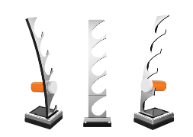
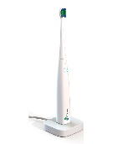

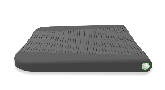






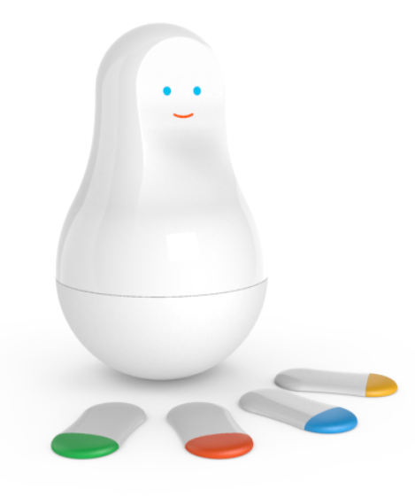
















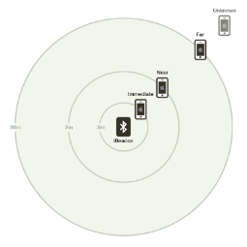
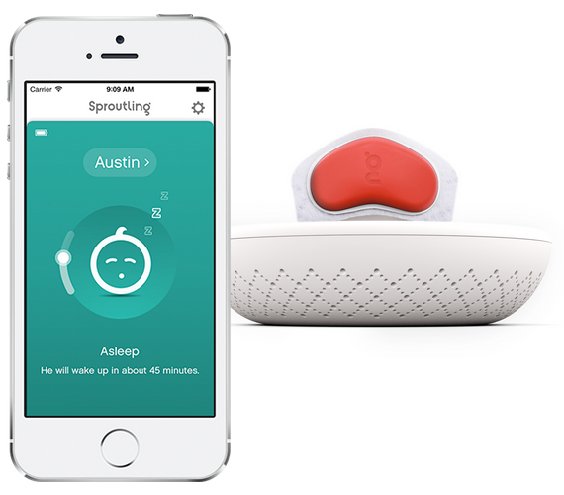














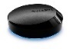



























































IoT 2015
Medication adherence
Health monitoring
Pet tracking
Behavior modification
Object tracking
Child and elder monitoring
Sports and fitness
Indoor navigation
Trip tracking and car health
Smart lighting
Beacons and proximity
COMMUTE
COMMUTE
HOME
WORKPLACE
HOME
Smart appliances
Food and nutrition tracking
Identity
Office equipment
Smart vending machines
Bike ride stats and protection
Air conditioning and temperature control
Sleep tracking
Environmental sensors
Information capture
Control
Home security
Home automation
Leak detection
Garden, lawn and plant care
New devices and sensors
Entertainment systems

Slide 44

Notes:
Trimble Video – HoloLens
2 mins

Slide 45


You’ve come to the right room!

Slide 46
Microsoft Student Accelerator!

Slide 47
Username: conf9216 Password: 2arotard Username: conf9217 Password: ndinka5a
WiFi:

Slide 48
msa.ms/drive msa.ms/github
Resources:

Slide 49
Microsoft Student Accelerator!
Training from MSPs (students) for students
Supported by Microsoft
Training + Work Placement
Meet people, learn new things and have fun along the way!

Slide 50
Need Help?
MSA Facebook Group! – Drop Deep SeaDev a line!
nzedu@microsoft.com – Programmatic questions

Slide 51
Phase 1
MVA Content on C#
Built a Windows app and familiar with Windows
Visual Studio + Windows / Mac

Slide 52

Key Dates & Progress

Slide 53
Phase 2

Slide 54
Phase 2
Training Events
Individual Assessments
Imagine Cup Training
Group Assessments
Employer Speed Dating
Networking Drinks

Slide 55
Phase 2 - Dates
Day | Date | Description
Friday | 20th November | In-Person Training
Saturday | 21st November | In-Person Training
Sunday | 22nd November | In-Person Training
Monday | 23rd November | Support Labs and Office Hours
Friday | 27th November | Assessments Day
Saturday | 28th November | Groups Announced/Imagine Cup
Sunday | 29th November | Imagine Cup
Monday | 30th November | Imagine Cup
Tuesday | 1st December | Networking Evening
Wednesday | 2nd December | Placements Announced

Slide 56
Phase 2 - Training
Day 1
Introduction to Source Control
Introduction to Web App development
HTML, CSS, JS, Ajax and more…
Day 2
Introduction to API development
APIs, Swagger, mySQL, EF, App Insights, VSTS and more…
Day 3
Optional features development
Auth, JQuery, xPlat, ManifoldJS

Slide 57
Today
Time | Topic
9:30 to 10:00 | Gates open
10:00 to 11:15 | Welcome
11:15 to 12:00 | Introduction to Source Control via GitHub
12:00 to 12:30 | Ice-breakers!
12:30 to 13:30 | Lunch Break
13:30 to 14:00 | Fun Quiz
14:00 to 14:45 | Web I - Introduction
14:45 to 15:30 | Web II – Deep Dive
15:30 to 15:45 | Break
15:45 to 16:45 | Web III – Deep Dive
16:45 to 17:00 | Recap

Slide 58
Saturday
Time | Topic
9:30 to 10:00 | Gates Open
10:00 to 10:30 | Welcome
10:30 to 11:15 | API I - Introduction
11:15 to 12:30 | API II - Dev
12:30 to 13:30 | Lunch
13:30 to 15:00 | API III - Dev
15:00 to 15:30 | Break
15:30 to 16:15 | Web IV – Publish and ALM viaVisual Studio Online
16:15 to 16:45 | Application Insights
16:45 to 17:00 | Closing

Slide 59
Sunday
Time | Topic
9:30 to 10:00 | Gates Open
10:00 to 10:45 | Welcome
10:45 to 12:00 | Authentication
12:00 to 13:00 | Lunch
13:00 to 13:30 | xPlat
13:30 to 14:15 | ManifoldJS
14:15 to 15:15 | DIY xPlat
15:15 to 16:00 | JQuery Plug-ins
16:00 to 16:30 | DIY JQuery

Slide 60
Assessments

Slide 61
Assessments
To be placed, you must complete assessment
In person only
Time Slot booking will be released soon

Slide 62
Assessments - Deliverables
Required:
Web Component
API Component
Additional Features (Minimum 2):
Authentication
JQuery Plug-ins
Cross-Platform Hosted App (through Manifold JS)
Source-Controlled via GitHub and Managed via Visual Studio Online
And more..

Slide 63
msa.ms/drive
Assessments - Scenarios

Slide 64
Assessments - Scenarios
Two main scenarios
Contoso
Nandoso
Or Your own
Similar Workload

Slide 65
Scenario 1 – University of Contoso

Slide 66
University of Contoso
Project Description:
The University of Contoso is an internationally renowned education institute that provides a variety of degrees options to over 20,000 students across multiple campuses. Many students have complained about lack of personalised information and the IT team would like to address this quickly by creating a Web App that can deliver this. The app will be standalone for now, but will have the potential to be integrated into the university system later on.

Slide 67
Scenario 2 – Nandoso

Slide 68
Nandoso
Project Description:
Nandoso is an international casual dining restaurant chain, operated by franchisees, that specializes in flame-grilled chicken. The Nandoso Mt Eden franchise is frequently visited by Microsoft Student Partners, and influenced by their tech talk, the manager would like to create an in-store Web App for customers to improve their customer service and add value to their restaurant.

Slide 69
Assessments - Presentations
15-minute time slots
7-9 minutes of Presentation
Slides
Introduce yourself
Explain your Scenario
Demo your solution
3-5 minutes of Questions and Answers

Slide 70
Assessments - Presentations
Bookings Open at:
Saturday, 21st November 2015
After Lunch break
msa.ms/drive > Phase 2 > Assessment Centre

Slide 71
Key Advice & Tips
Every student that passes assessments will be placed
Self learning is the best learning
Use us as a guide and not gospel
HAVE YOUR DEV ENVIRONMENT READY TO GO

Slide 72
Key Advice & Tips
Need Help?
MSA Facebook Group! –
Drop Deep SeaDev a line!
nzedu@microsoft.com
Monday 23rd November: AM/PM Skype Sessions

Slide 73
Any Questions on Assessments?

Slide 74
Groupings

Slide 75
Groupings
Based on Assessments
You give your preferences
We try to make the best match between skills, type of projects and your preferences!

Slide 76
Imagine Cup

Slide 77
Imagine Cup
More details to be shared
Fun team-building group exercise

Slide 78
Employer Matching

Slide 79
Employers
A pool of employers
Student Teams give their preferences
A panel of MSPs/Assessors will match the employers based on skills, projects and preferences!
More details to follow…

Slide 80
Feedback Form
Coming later today!

Slide 81
Any Questions?

